Slide 1
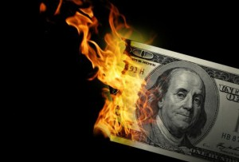
CS1951 L
Blockchains & Cryptocurrencies
Fall 2025
Lecture 23
Stablecoins
Maurice Herlihy
Brown University

Slide 2
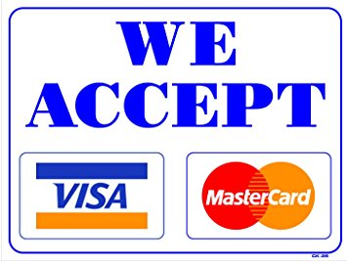
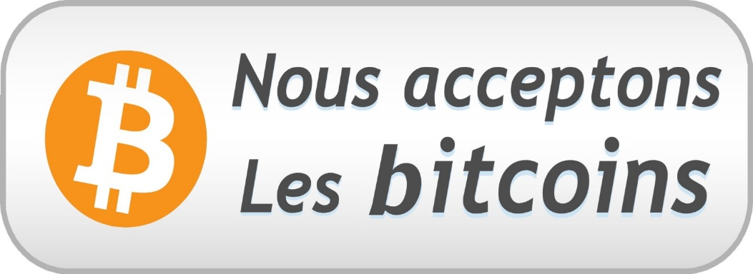
Retail Cryptocurrency?

Slide 3
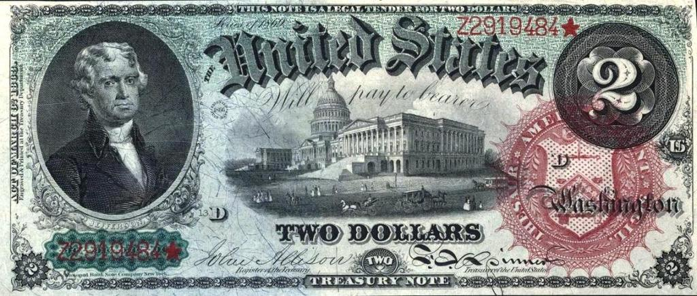
What is Money for?
For BTC, mostly speculative
store of value
(keep under mattress)
Medium of exchange (buy beer)
For BTC, not happening
3

Slide 4
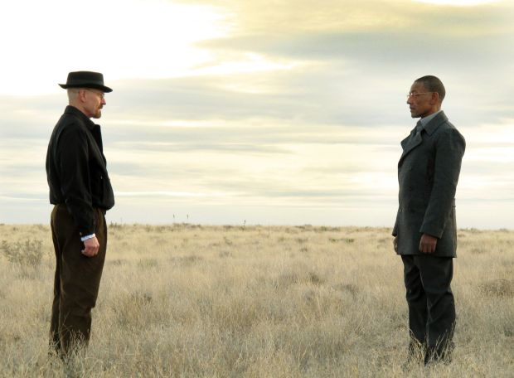
Number go up
Why should I spend coins worth more tomorrow?
Why should I take coins worth less tomorrow?
Number go down
Buyer
Seller

Slide 5
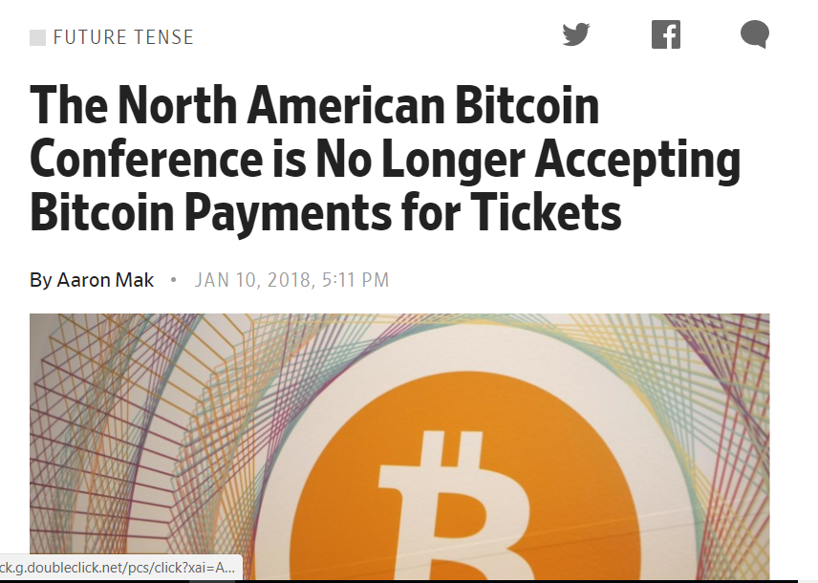
Practical Aspects vs Ideology

Slide 6
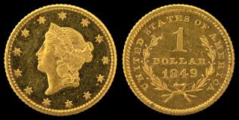
Stablecoins
What if there were a coin …
backed by fixed-value assets?
Like fiat? Crypto basket? T-Bills?
asset price stable ⇒ coin price stable
Ease & convenience of on-chain trading

Slide 7
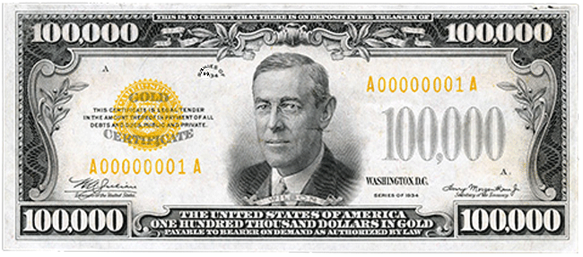
Not a New Idea
I am a 1930s stablecoin!
“One Hundred thousand dollars in gold payable to bearer on demand …”
Paper replaces
88.86 kg ≈ 195.9 lbs. gold

Slide 8
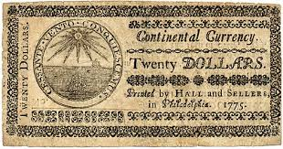
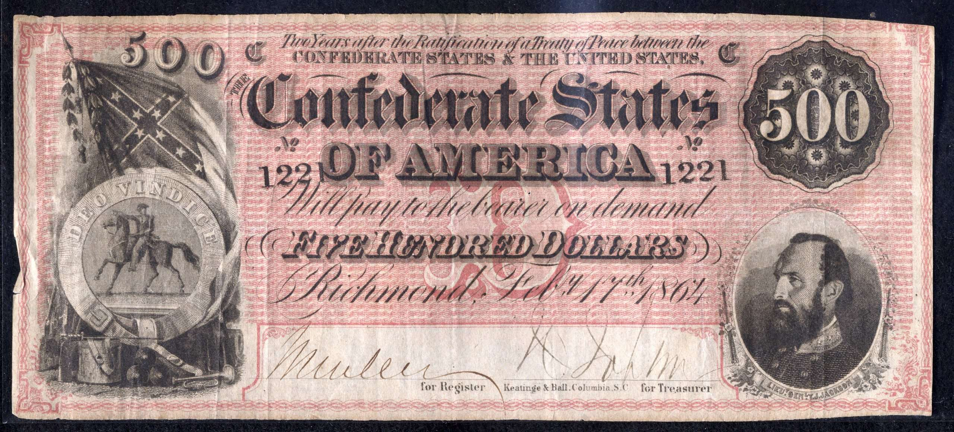
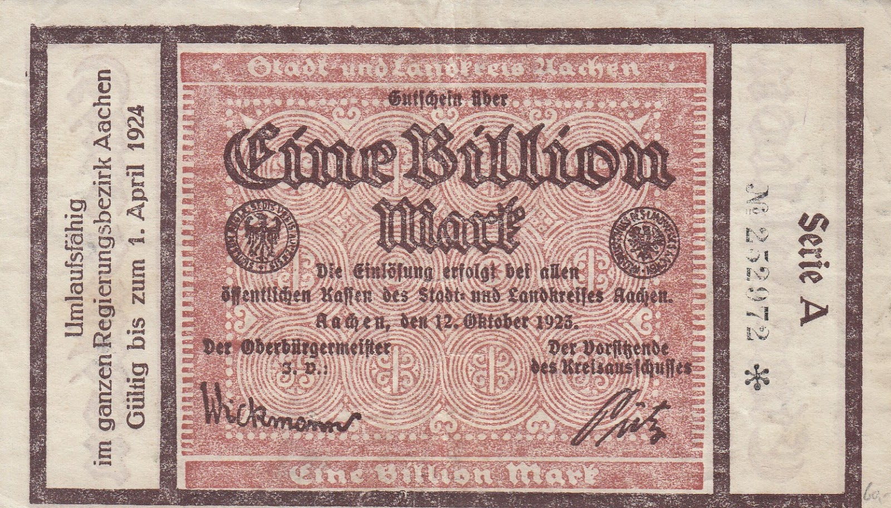
Success not Guaranteed
Notes:
Of course not all paper money was successful. Here is a continental dollar, issued to finance the American war of independence. It gradually lost all its value as the war went on. CLICK This is confederate money, which lost all value at the end of the American civil war. CLICK Finally, here is a one billion mark banknote from Germany’s Weimar republic in the 1930s. Each of these notes gradually, or suddenly, lost the public’s confidence, and hence its value.

Slide 9
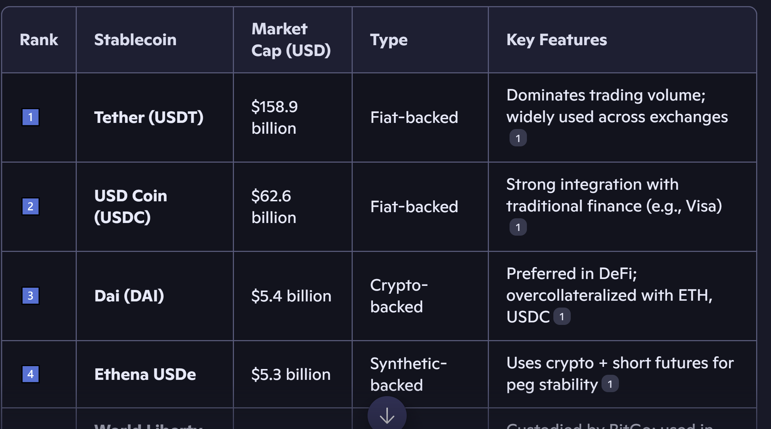
Top Stablecoins Today

Slide 10
Stablecoins Today
Lots of $$$

Slide 11
Stablecoins Today
Variety of backing schemes

Slide 12
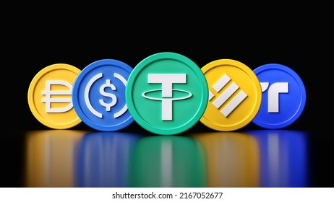
Definitions
Backing:
What kind of assets support the coin’s value?
Peg:
The coin’s target value (e.g., ≈ $1)

Slide 13
Kinds of Stablecoin Backing
Fiat or other real-world asset
USDT, USDC, …
Overcollateralized crypto assets
DAI, …
Algorithmic
Terra/Luna, Iron/Titan, …

Slide 14
Kinds of Stablecoin Backing
Fiat or other real-world asset
USDT, USDC, …
Overcollateralized crypto assets
DAI, …
Algorithmic
Terra/Luna, Iron/Titan, …

Slide 15


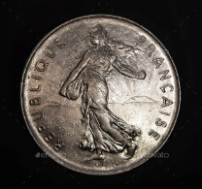
Fiat-Backed
I have $100 locked up somewhere!
I will now issue $100 worth of stablecoins!

Slide 16



Fiat-Backed
Willing to accept coins at face value …
… as long as we believe $100 locked up!

Slide 17

Tether (USDT)
Highest market cap: $159B
Backed by cash, commercial paper, etc.
1 USDT ≈ $1 USD
Trading, liquidity, cross-border payments
How you would buy bitcoin

Slide 18

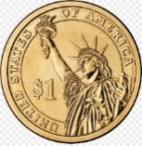
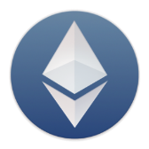
Fiat-Backed
I want to convert my BTC to ETH
Conversion via USD & bank means delay, regulation,
capital gains taxes

Slide 19
Fiat-Backed
I want to convert my BTC to ETH
Conversion via USDT swift, painless, everything on-chain

Slide 20
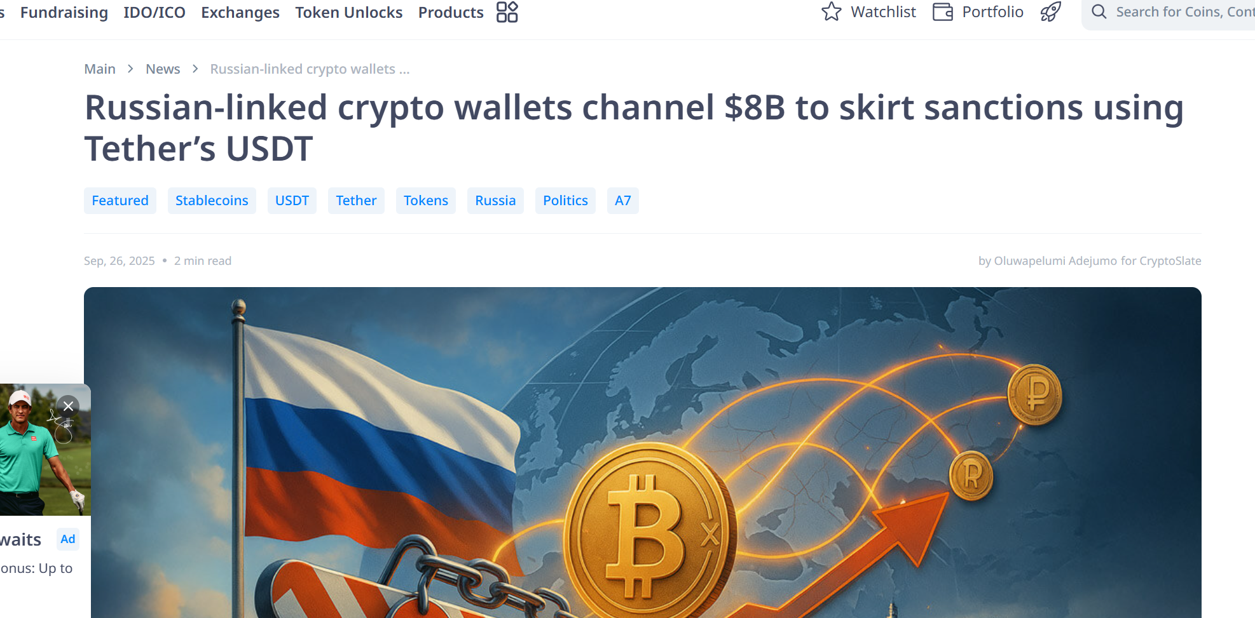
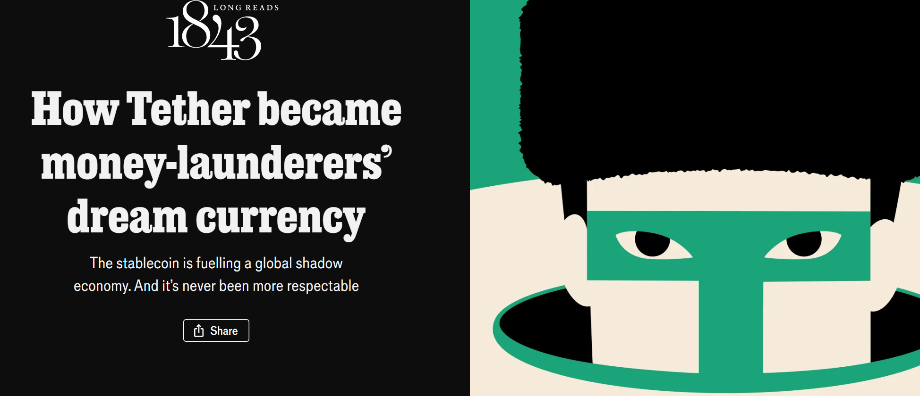
Controversy

Slide 21
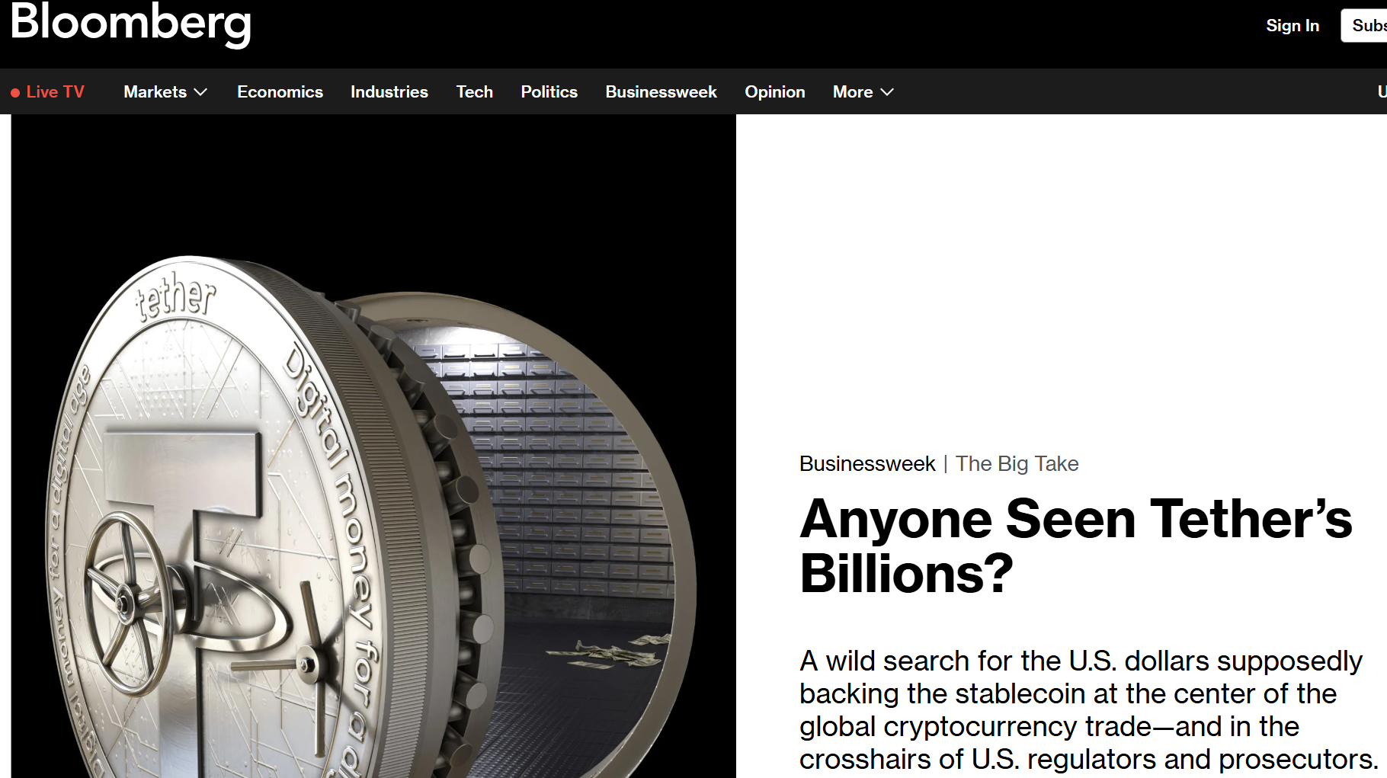
More Controversy
Tether claims to have assets to back every coin
No systematic audits
Math doesn’t quite add up?
Rumors and suspicions …
But public confidence remains strong

Slide 22

USDC
2nd Highest market cap: $62B
Backed by cash, T-bills
1 USDC ≈ $1 USD
External audits
Regulatory compliance

Slide 23
USDC Uses
Safe Haven from volatile crypto
Defi medium of exchange
Global payments
Where compliance matters

Slide 24
GENIUS Act (2025)
Only licensed issuers
1-1 backing
Liquid assets: cash, T-Bills, etc.
No interest or yield
Full disclosure of assets
Bankruptcy priority
Other conditions …

Slide 25
Kinds of Stablecoin Backing
Fiat or other real-world asset
USDT, USDC, …
Overcollateralized crypto assets
DAI, …
Algorithmic
Terra/Luna, Iron/Titan, …

Slide 26

Overcollateralized Loans
I believe my ETH will someday be very valuable …
But I want it to work for me in the meantime!
Notes:
Alice owns a pile of ETH. She thinks it has great long-term growth prospects, so she doesn’t want to sell it, but she does want to earn some kind of return on it while she is waiting for it to go over the moon.

Slide 27
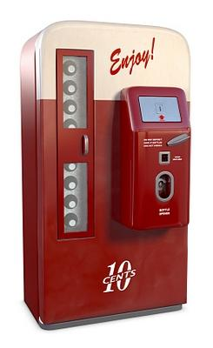
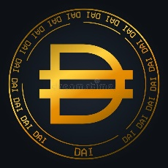
Overcollateralized Crypto
I am a DAI smart contract
I will mint & lend you $100 in DAI stablecoins
If you give me $150 collateral in ETH

Slide 28
Overcollateralized Crypto

Slide 29
Overcollateralized Loans
You can have your ETH back when you repay the loan
I can deposit these stablecoins & collect interest
Notes:
Alice is happy because she can invest the stablecoins in venues that would not accept volatile cryptocurrencies. In particular, there are a number of venues that will pay about 5% interest on stablecoins. The DAI smart contract

Slide 30
Number Go UP
ETH just went up
I will benefit when I reclaim my ETH!

Slide 31
Number Go DOWN
ETH just went down
DAI-USD peg is in danger!
I will liquidate (auction off) the collateral before it is too late!
Notes:
Suppose instead that the value of ETH drops. If it drops too far, then the stablecoin peg would become endangered, so before that happens the DAI system will liquidate the collateral, putting it up for auction, replacing the ETH with DAI.

Slide 32
Number Go DOWN
I was able to cover costs!
I lost my ETH but I still have the DAI

Slide 33
Number Go DOWN
But what if the auction didn’t cover costs?

Slide 34

MKR Token
Absorbs risk
Governance rights

Slide 35
When the Peg is Strong
DAI buys back & burns MKR tokens
Tokens become scarcer, more valuable
Deflationary effect
Token holders benefit

Slide 36
When the Peg is Weak
Mint and auction off new DAI tokens
Lowers value of DAI tokens
Inflationary effect
Token holders pay for stability

Slide 37
Number Go DOWN
But what if the auction didn’t cover costs?
I will mint & auction off MKR tokens …

Slide 38
Number Go DOWN
But what if the auction didn’t cover costs?
I will mint & auction off MKR tokens for DAI …
Diluting current MKR holders

Slide 39
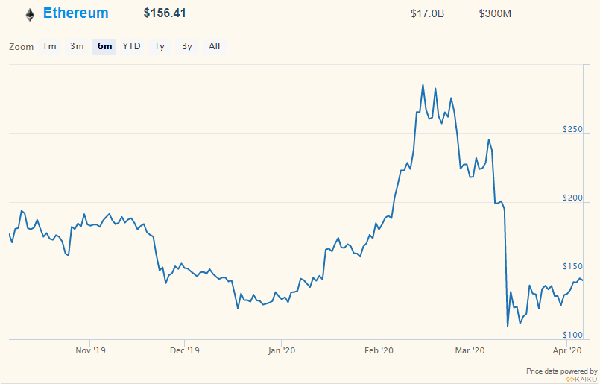


12 March 2020
“Black Thursday”
Amid pandemic fears
ETH price drops ~50% in hours

Slide 40
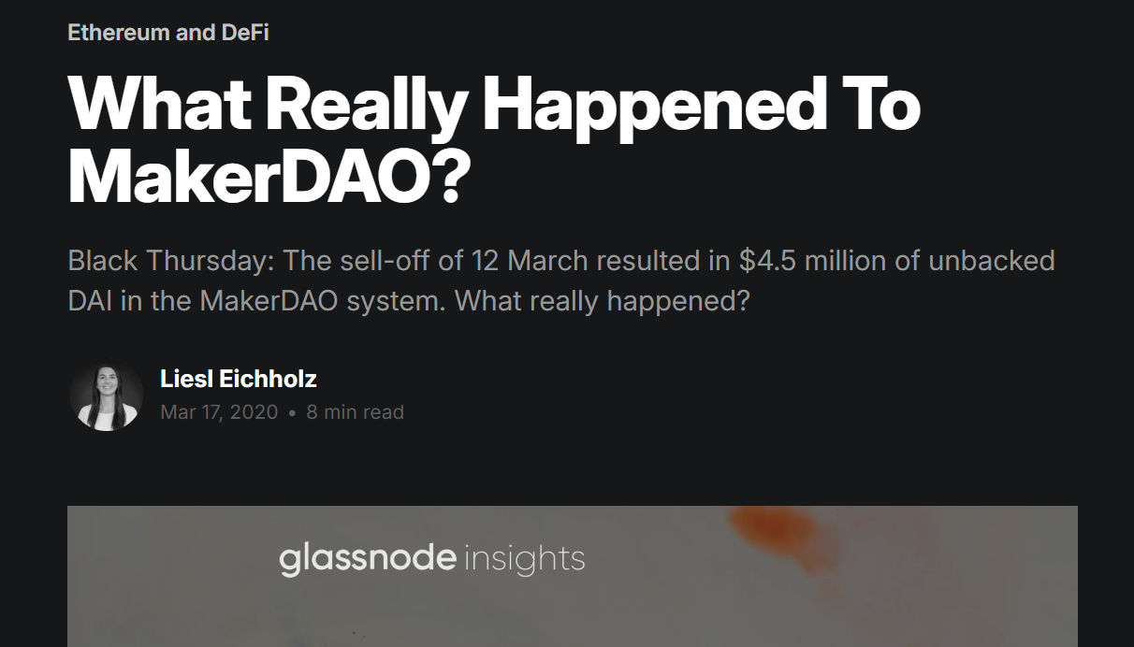
12 March 2020
Panic!
Ethereum network becomes overwhelmed
Transactions queue up
Gas prices spike: from 15 to 200+ Gwei

Slide 41
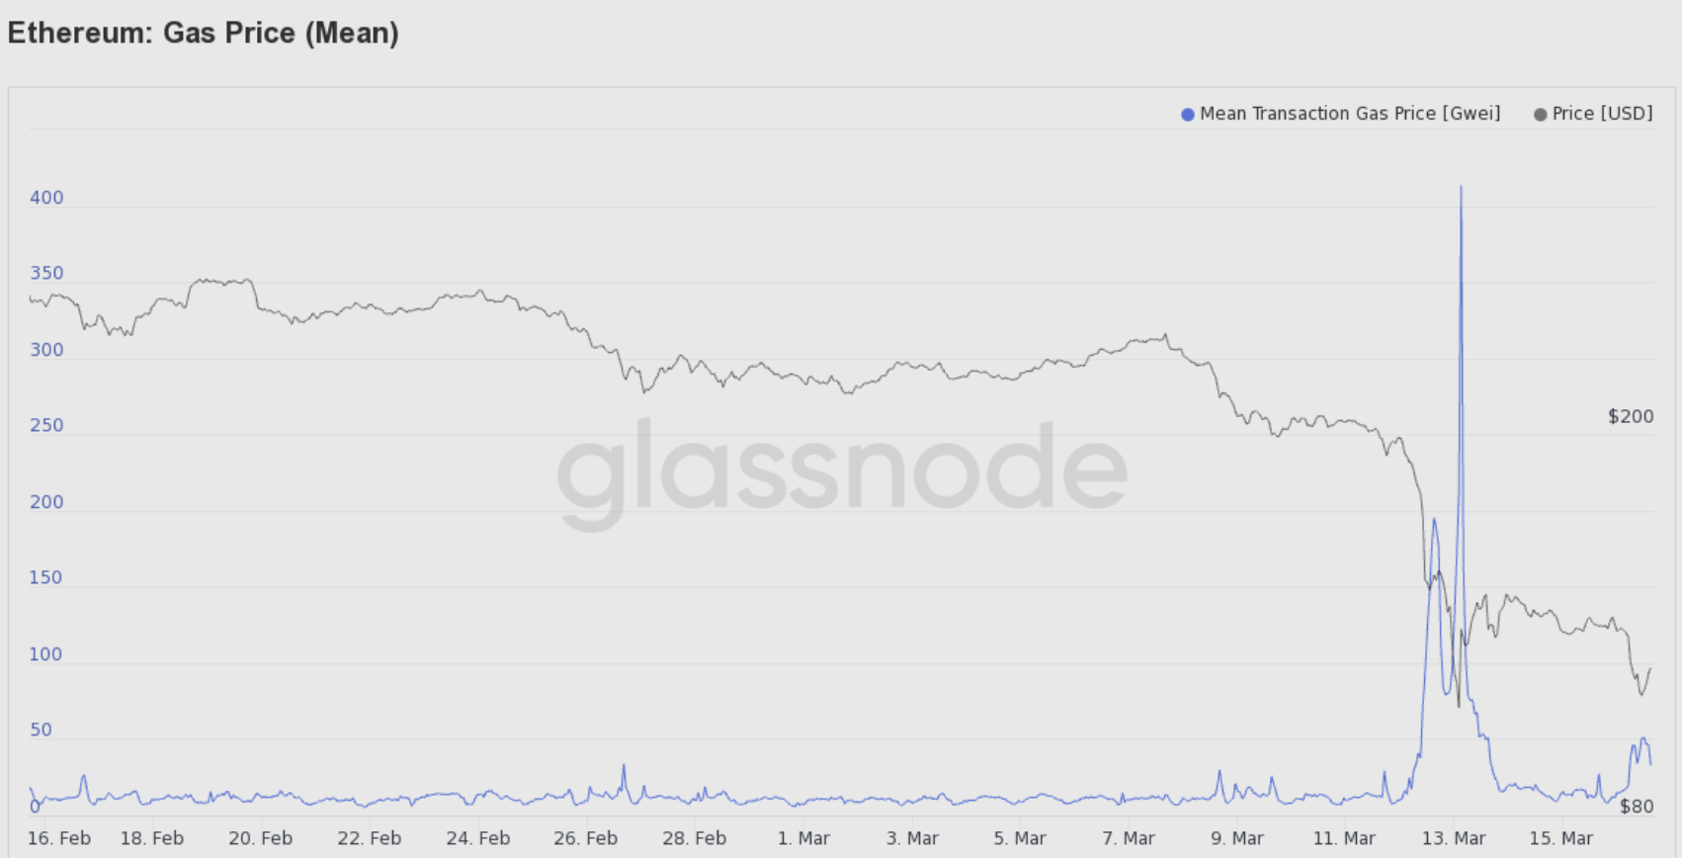

Gas Prices

Slide 42
12 March 2020
Oracles (price feeds) become confused
Triggering mass liquidations!
Auction off DAI but few bids…
Zero-bid exploits appear
$5.67M bad debt

Slide 43
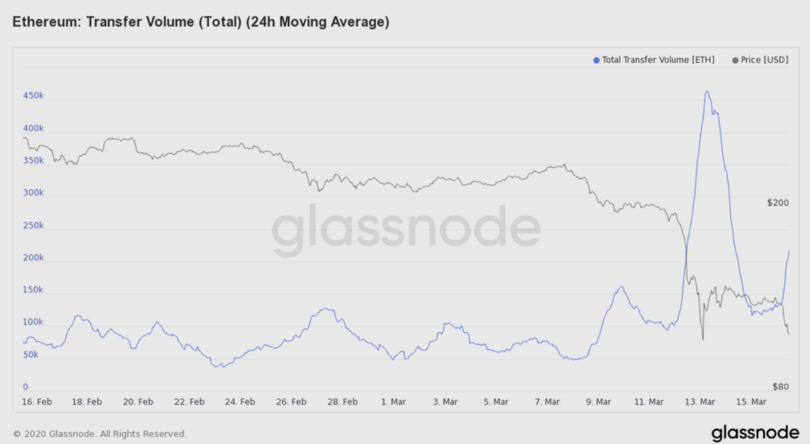

Transfer Volume

Slide 44
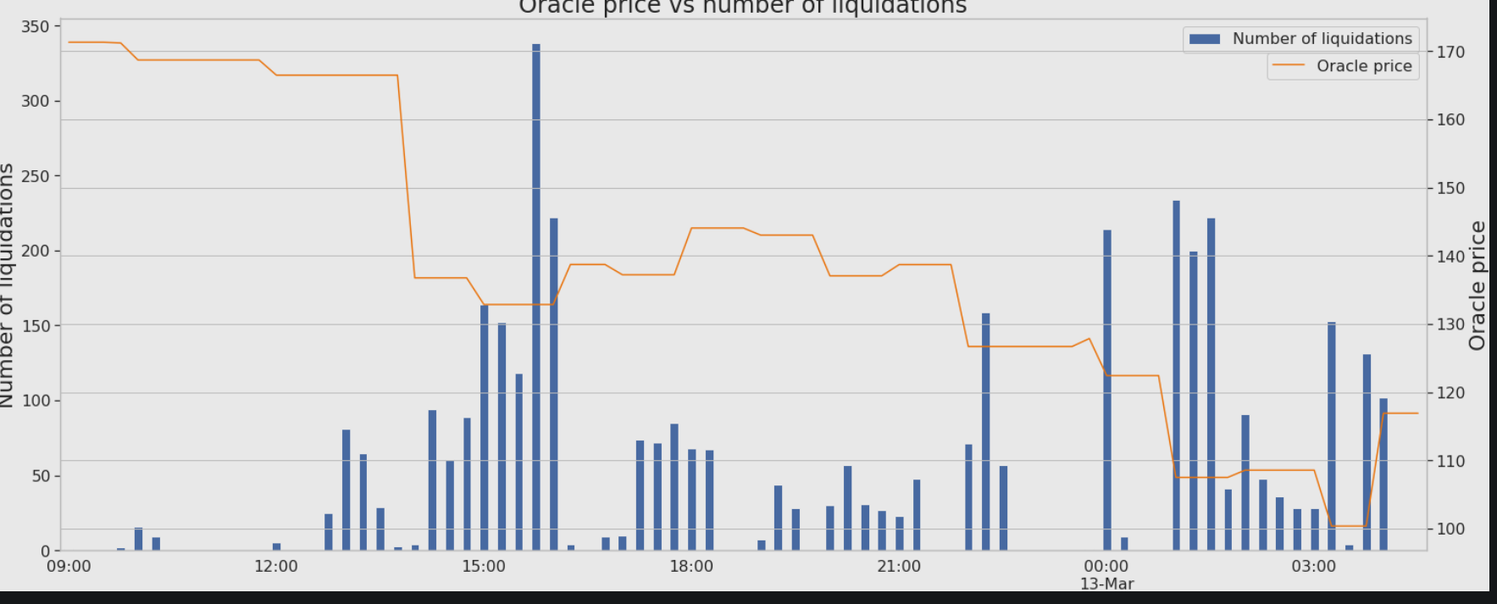
Liquidations

Slide 45
12 March 2020
Emergency vote to mint & auction more MKR
Reforms: new collateral types, circuit breakers, better auctions, etc.
But DAI stable coins survive

Slide 46

Summary
DAI is decentralized, unlike fiat-backed coins
Governed by a DAO
Collateral types, interest rates, etc.…
Transparent: all done by contracts
DAI has proved robust during crises
Widely used for DeFi, less for retail

Slide 47
Kinds of Stablecoin Backing
Fiat or other real-world asset
USDT, USDC, …
Overcollateralized crypto assets
DAI, …
Algorithmic
Terra/Luna, Iron/Titan, …

Slide 48
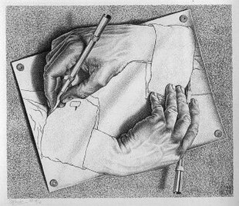
Let’s build an Algorithmic Stablecoin!
The Rules:
If coin supply decreases, price increases
If coin supply increases, price decreases
Price oracles accurate & timely
Parties seek to increase holding value
(not always true in real world)

Slide 49
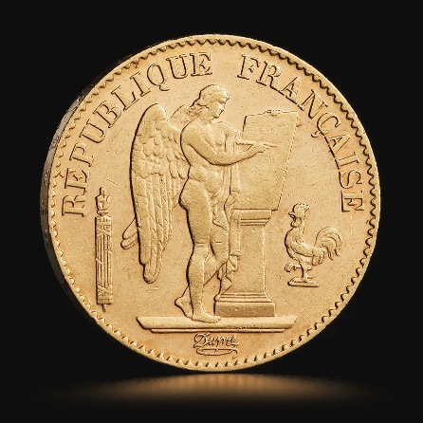
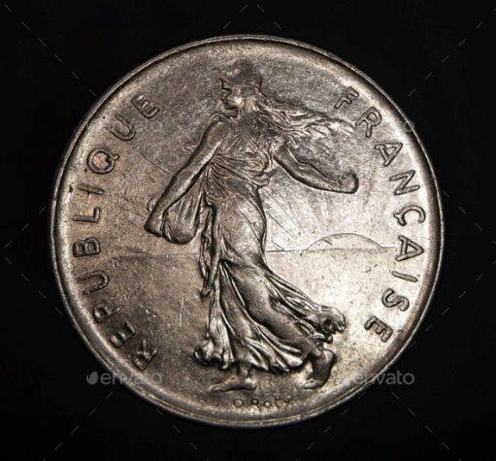
Stable vs Spec Coins
Variable Price
$1 peg
Absorbs volatility, risk
Invest?

Slide 50
Stablecoin Contract Functions
Burn 1 stablecoin,
mint $1 worth of spec coin
Burn 1 spec coin,
mint $1 worth of stablecoin

Slide 51
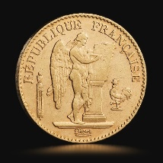

When stablecoin < $1
Burn 1 stablecoin in exchange for $1 worth of newly-minted spec coin

Slide 52
When UST < $1
Burn 1 stablecoin in exchange for $1 worth of newly-minted spec coin

Slide 53
When UST < $1
Small profit from exchange
stablecoin scarcer, hence more expensive

Slide 54
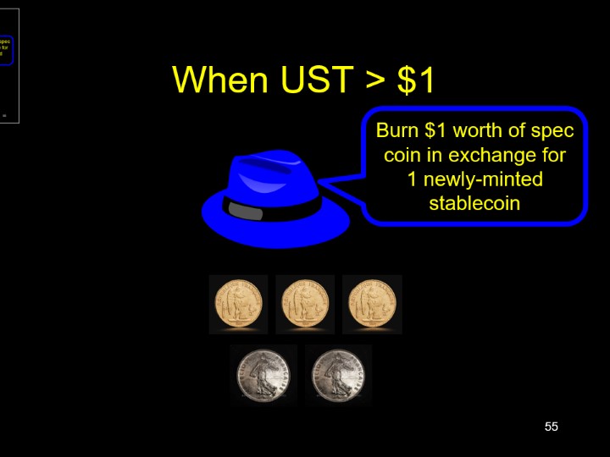

When UST > $1
Burn $1 worth of spec coin in exchange for 1 newly-minted stablecoin

Slide 55
When UST > $1
Burn $1 worth of spec coin in exchange for 1 newly-minted stablecoin

Slide 56
When UST > $1
Small profit from exchange
stablecoin more common, hence cheaper

Slide 57
Theorems
As long as the rules hold, stablecoin price should ≈ $1
Strong peg (high stablecoin demand) makes spec coin more valuable
Weak peg (low stablecoin demand) makes spec coin less valuable

Slide 58
Terra: UST/Luna (2018-2022)
UST
Luna
not actual logos
Volatile
Stable, $1 peg
Keeps UST Stable
Also governance

Slide 59

Anchor Protocol
Decentralized borrowing, saving, lending
Offered ~20% interest on UDT deposits!
Created huge demand …
Spoiler: unsustainable

Slide 60
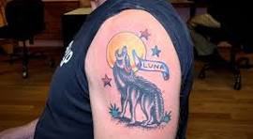
Early Success
One of the most successful coins ever
Top 3: market cap of $50-$60 billion
Luna: price peaked at $199 April 2022
Anchor protocol peaked at $14B TVL
Galaxy Digital CEO and crypto billionaire Mike Novogratz

Slide 61
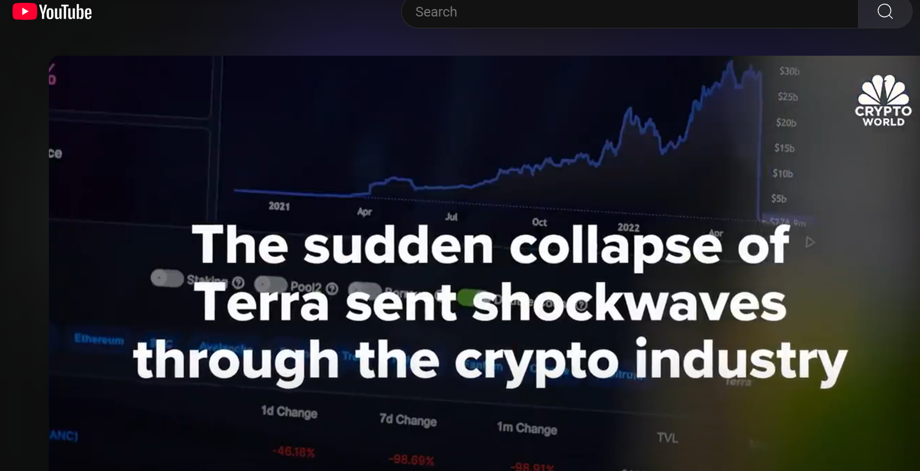
7 May 2022
Whales suddenly exit anchor, sell $10Ms UST
Peg drops to $0.98
Bank run! Everyone burns UST to buy Luna
Hyperinflation: Luna goes from $60 to $0.00008
$60B value evaporates
Founder eventually convicted of fraud in US

Slide 62
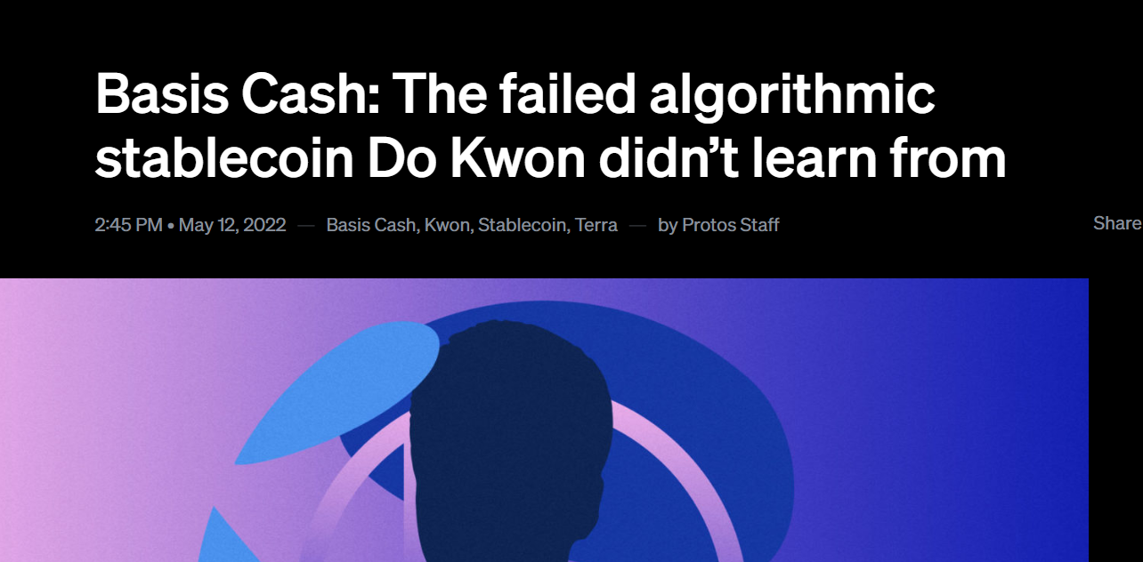
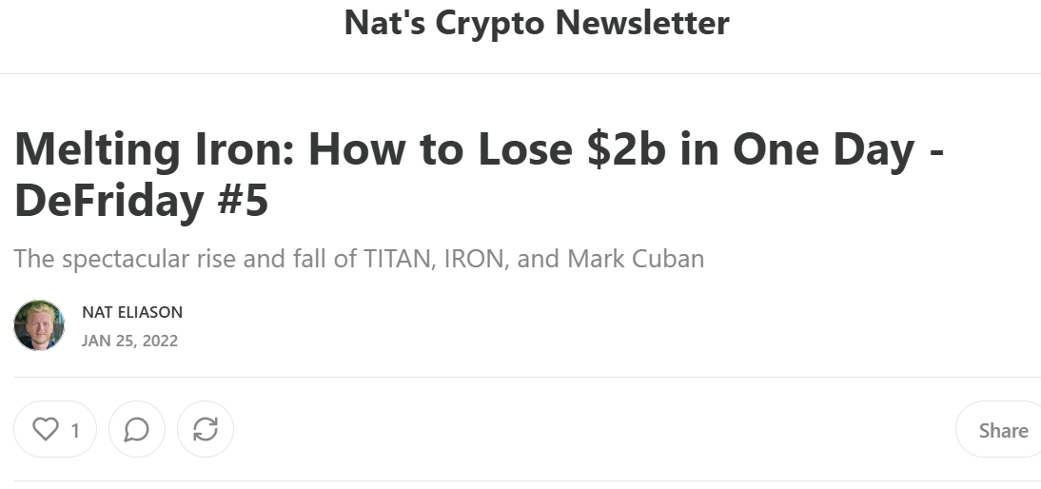
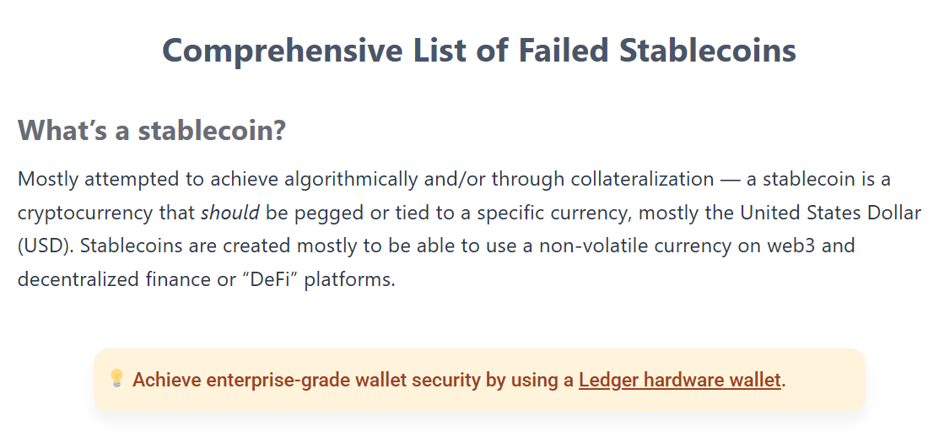
Not Just Terra

Slide 63
Stablecoin Flavors
Fiat or other real-world assets
Widely used, regulated, going mainstream?
Overcollateralized crypto assets
Used for DeFI, awkward for retail
Algorithmic
We must never speak of this again

Slide 64
Stablecoin Flavors
Fiat or other real-world assets
Widely used, regulated, going mainstream?
Overcollateralized crypto assets
Used for DeFI, awkward for retail
Algorithmic
We must never speak of this again

Slide 65
Stablecoin Flavors
Fiat or other real-world assets
Widely used, regulated, going mainstream?
Overcollateralized crypto assets
Used for DeFI, awkward for retail
Algorithmic
We must never speak of this again

Slide 66
Central Bank Digital Currencies

Slide 67
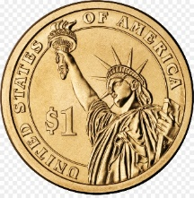
CBDCs
What if the government issued a fiat-backed coin?
Directly by central bank? (The Fed)
Not physical cash, not crypto

Slide 68
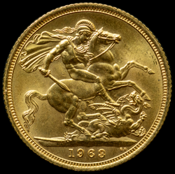
Why?
Declining cash usage
Compete with crypto
Compete with other CBDCs (Europe, China)
Better control over monetary supply

Slide 69
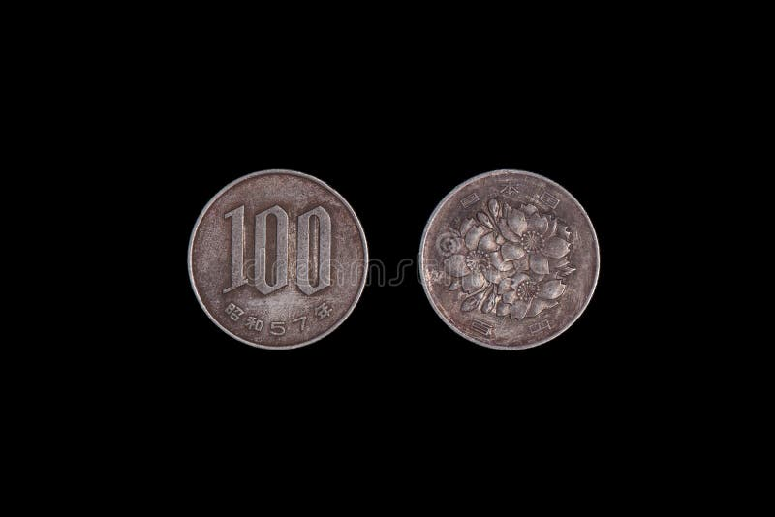
How?
Account vs UTXO?
One tier: central bank direct to citizens
Two tier: central bank through intermediaries
Better control over monetary supply

Slide 70
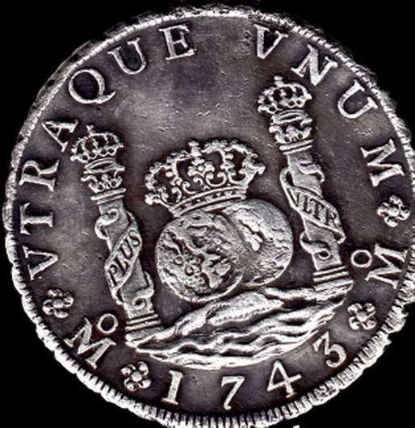
Privacy?
Full anonymity (like cash)
Full traceability (anti money laundering)
Two tier: only small transactions private
ZK proofs, blind signatures, etc.?

Slide 71
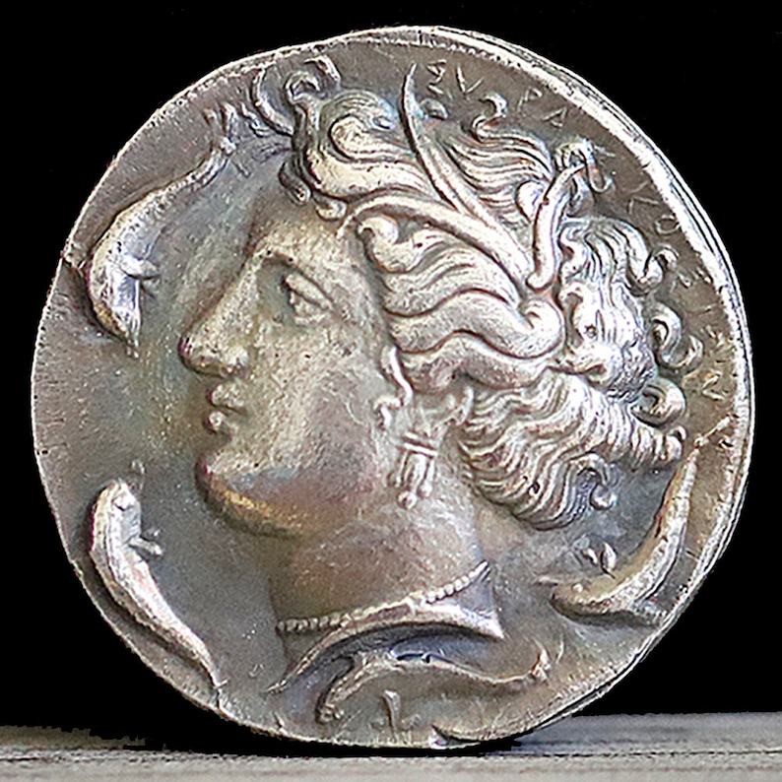
Platform?
Centralized DB?
Blockchain?
Resiliency important!
Target for hackers, electronic war, etc.

Slide 72
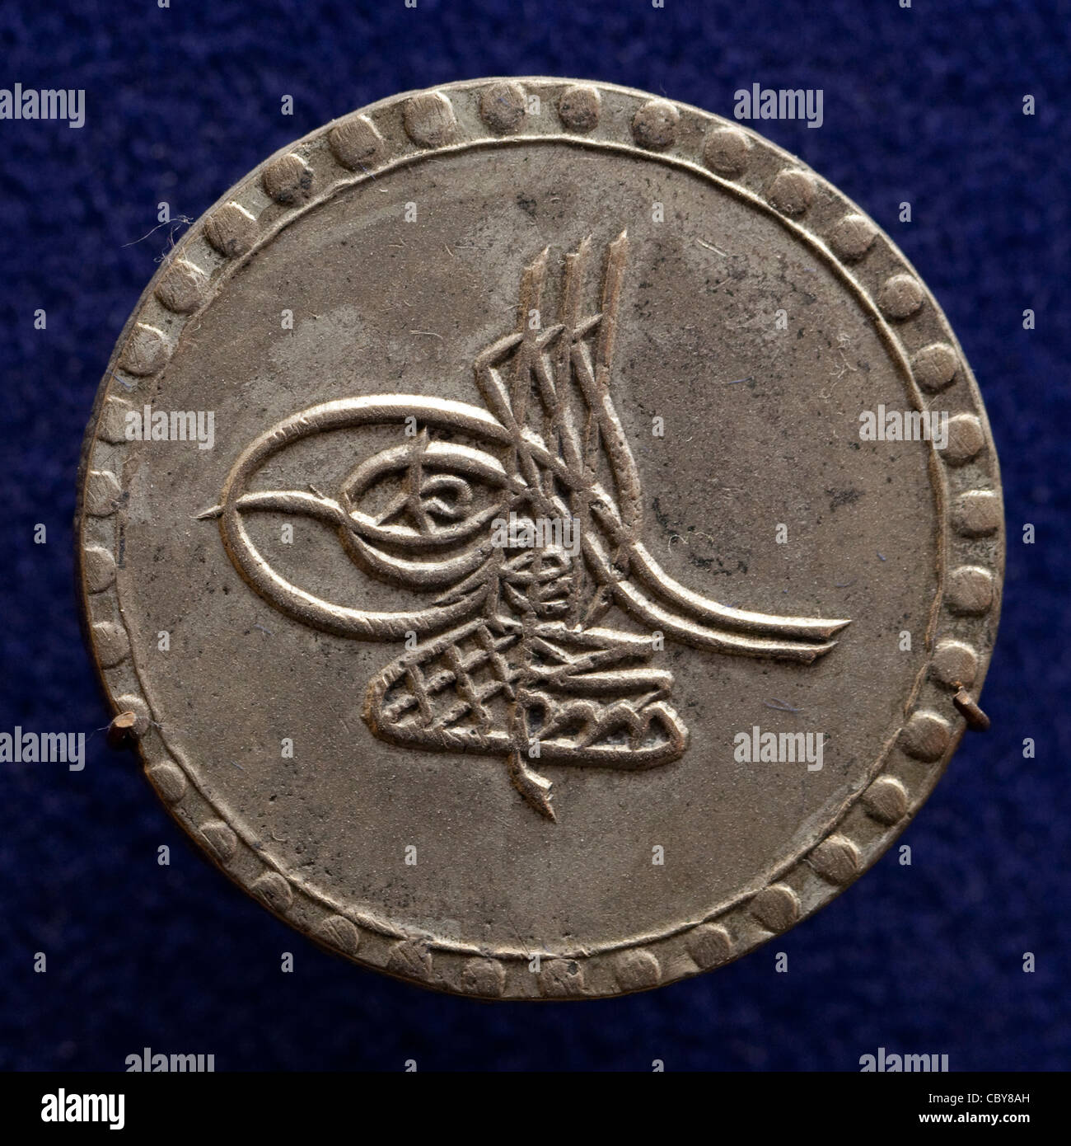
Potential Benefits
Inclusion for unbanked
More efficient payments
Stimulus, negative interest
Smart contracts
Less tax evasion, corruption

Slide 73
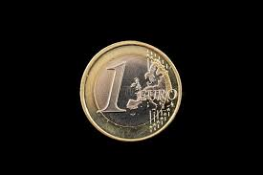
Potential Challenges
Banks lose deposits, harms economy
Digital bank runs hard to control?
Privacy
Security
Government not good at customer service

Slide 74
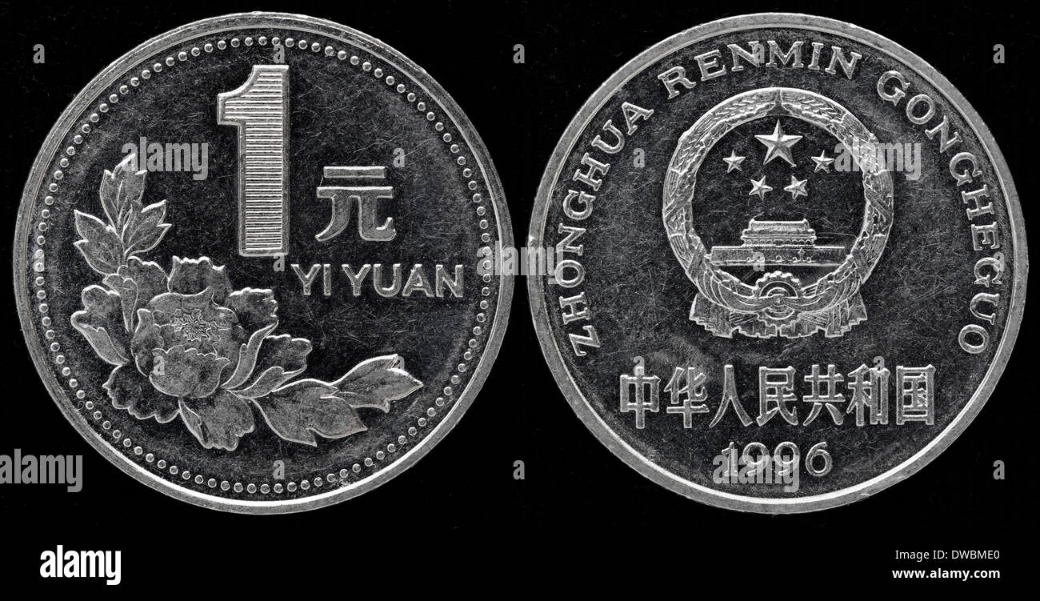
Prototypes
Bahamas Sand Dollar (2020)
Nigeria eNaira (2021)
Jamaica JA-DEX (2022)
China e-CNY: large-scale pilot
Maybe Euro, Pound, USD, …

Slide 75

Ideas we covered in this lecture
Why stablecoins are needed
Stablecoins are a big business
Fiat-backed
Overcollateralized loan-backed
Algorithmic
CBDCs

Slide 76
